Slide 2
Helicobacter Pylori Infection in Children: Introduction & Diagnosis
Dr Maryam.Shoaran
Pediatric Gastroenterologist
Tabriz University of Medical Sciences

Slide 3
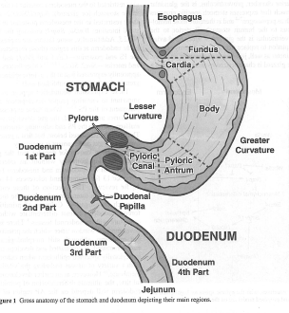
Stomach
From a functional and histological point of devided into:
Cardia,
Fundus or oxyntic,
Antrum

Slide 5
Gastritis and peptic ulcers
In children mostly due to H.Pylori.
Definition:
Peptic Ulcers: Deep mucosal lesions disrupting the muscularis mucosa
Peptic erosions: Superficial lesions
Location:
Gastric ulcers: on lesser curvature
Duodenal ulcers : Duodenal bulb.

Slide 6
Gastric ulcer disease
60% of adults with gastric ulcer are infected by H.pylori, in children not clear.
Duodenal ulcer disease
90% of children and 80% of adult who suffer from duodenal ulcer are infected by H.pylori.

Slide 7
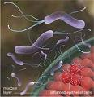
H.Pylori
In 1983, Warren and Marshall reported an association between spiral-shaped organisms on the gastric mucosa and antral gastritis.
Gram negative flagellated spiral bacterium.
An important cause of chronic gastritis.

Slide 8
H.Pylori
Location: within and beneath the mucous layer on the gastric epithelium.
In duodenum, esophagus (barret), meckel diverticulum, rectum.
Usually acquired under 3 yr and if left untreated is lifelong
Under 1 yr rare even if mother is infected

Slide 9
Helicobacter pylori prevalence in populations worldwide

Slide 11
Transmission
Only reservoir is human stomach
Person to person
Mother to child ,Older siblings, Fathers
Fecal- oral
oral- oral
gastric- oral

Slide 12
Mechnism of disease
Bacterial virulence factors:
Motility(flagella)
Adherence to the gastric mucosa
Urease activity
Toxin production(Cag A)
Subversion of host cell signal transduction
Host inflammatory response
Majority of damage is a direct consequence of host immune response

Slide 14
Gastric acid secretion
A direct correlation between H. pylori and acid secretion is not known.
There is an overlap in gastric acidity in normal population and infected persons.
Acute infection: transient hypochlorhydria that facilitates the transmission of infection.

Slide 15
Symptoms
H.pylori Gastritis: In the absence of ulcer, usually asymptomatic.
Episodic epigastric pain
Vomiting (if with pain very suggestive)
Nocturnal awakening
Hematemesis, Melena

Slide 16
Non-Gastrointestinal Manifestation
Sideropenic anemia unresponsive to Iron
Idiopathic thrombocytopenic purpura(ITP)
Growth retardation
Urticaria

Slide 17
Gastric cancer & Mucosa-associated lymphoid tissue lymphoma(MALT)
Gastric cancer: Fourth most frequent cancer in the world and the Second leading cause of death.
More than 2-6 times in H.pylori infected persons
MALT : often multifocal, and located in the antrum or distal body.
Only those in the early stages respond to antimicrobial treatment.

Slide 18
Diagnosis
There are invasive and noninvasive tests for the diagnosis of H.Pylori infection in children.
Upper gastrointestinal fiber-optic endoscopy is the investigation of choice.

Slide 19
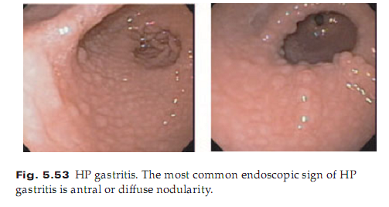
Nodularity of the antral mucosa is associated with H.pylori in children (cobblestone appearance)

Slide 20
Diagnosis
The gold standard for diagnosis is either pathologic assessment together with rapid urease test (RUT) or tissue culture on samples obtained by endoscopy.

Slide 21
Culture
Fastidious organism difficult to be cultured.
blood agar plates in Microaerophilic conditions at 37°C.
Medium containing Nalidixic acid or vancomycin (Skirrow medium).
Colonies usually require five to seven days.

Slide 22
Histology
Identifying spiral organisms on histologic sections of the gastric mucosa
Historically, the organism has been identified using a Warthin-Starry silver stain.
A modified Giemsa stain or a cresyl violet stain are both sensitive, specific, easy to perform and cost effective.

Slide 23
Rapid Urease test(RUT)
Hydrolysis of urea by the specimen in medium leads to color change of the medium.
Tan to pink color change , taking 30 minutes after inoculation up to 24 hours.
Less sensitive in children due to lower numbers of bacteria.

Slide 24
Non- invasive tests
Urea breath test(UBT)
Antibody detection(serology)
H.Pylori stool antigen test.

Slide 25
UBT
The 13C-urea breath test (UBT): a safe method in children older than 2 years.
After 2hr NPO , ingestion of 13C-urea + 50mg glucose polymere in 5-10 cc water.
50mg (<50kg patient), 75mg(>50kg patients)
The solution of urea should be swallowed quickly and not held in the mouth.

Slide 26
UBT
A second expired breath sample is then collected 30 minutes later.
The ratio of 12C to 13C is measured in baseline and 30-minute samples.
The difference calculated by subtraction.
In children, an excess delta of 3.5 indicative of H. pylori infection.

Slide 28
H.Pylori Stool antigen test
Stool antigen enzyme immunoassay
Polycolonal
Monoclonal: more accurate
The cost and convenience of stool antigen test makes it a very attractive test.
Like UBT, it is used for the evaluation of the success of treatment

Slide 29
Serology
Not a sensitive indicator of gastric colonization.
Mean antibody titers in young children lower than in older children and adults.
May not reach adult levels until the age of 7 years.
Neither sensitive nor specific in children younger than 12 years of age.

Slide 30
Treatment
Indications
Subjects with peptic ulcer.
MALT lymphoma.
Atrophic gastritis.
Sideropenic anemia(after exclusion of Celiac disease.
First-degree relatives of patients with gastric cancer.

Slide 31
Treatment
The children infected with H. pylori usually do not have peptic ulcer disease and are asymptomatic.
The diagnosis of H. pylori infection is often an incidental finding.
The management of these children is controversial.
“Test and treat” strategy

Slide 32
Thanks for Your Attention

